Slide 1
Goals for today:
(1) block-chains: key insights / reusable design techniques
(2) analyze the system from the perspective of the of various topics we’ve studied this term
Centralized vs. Decentralized
Distributed Agreement (e.g., Paxos vs. BitCoin’s heuristic on who will extend the chain)
Consistency Models / CAP
Incremental Scalability (vs. blockchain difficulty)
Hash functions and Merkel Trees
… generous topic 🡪 we will run out of time

Slide 2
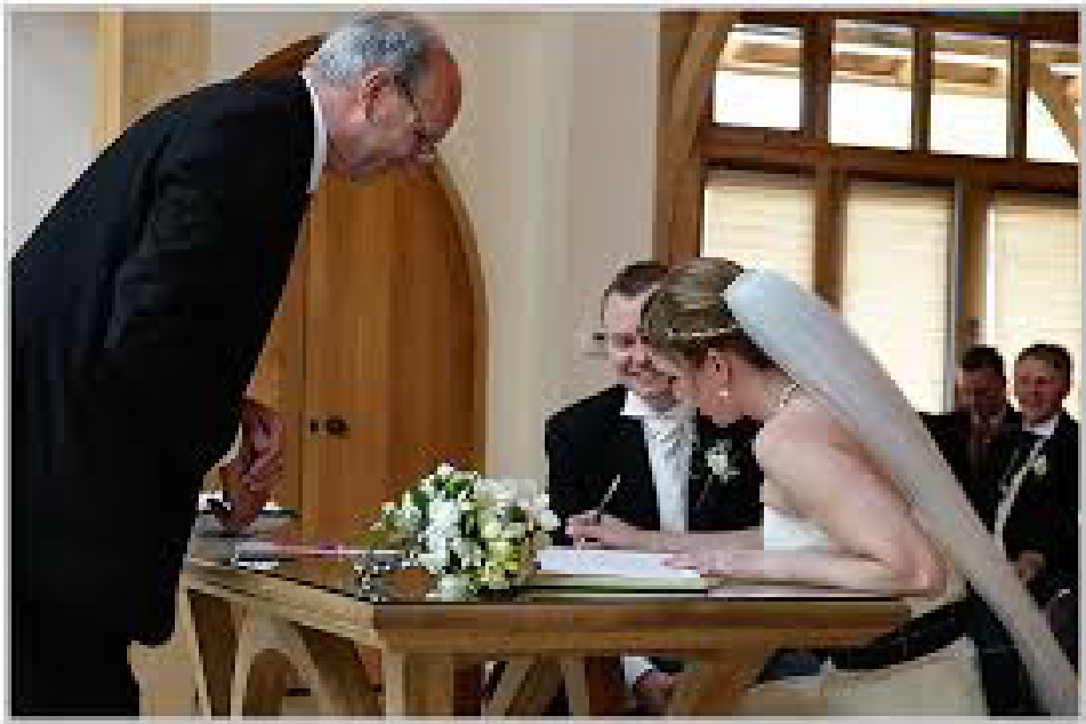

Block-chains:
a technological solution to aggregate a public tamper-proof ledger form untrusted sources
Perhaps with ability to enable users to selectively reveal information

Slide 3
What matters?
System resilience: fault-tolerance / robustness to attacks
Type of guarantees: 100% certainty vs. probabilistic
Ability to provide (some form of) privacy / anonymity
Bootstrapping the system
Costs: transactions, operating the system

Slide 4
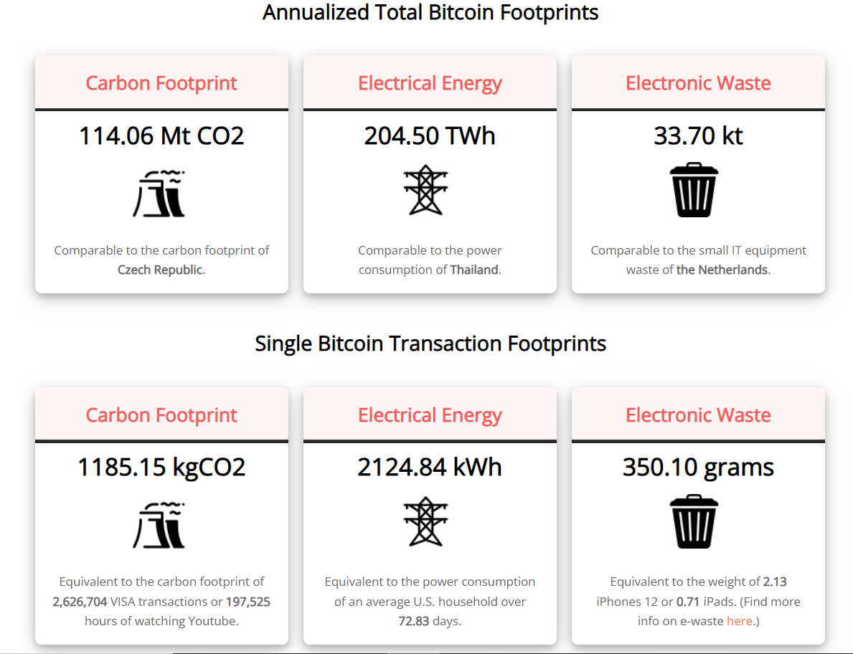
$20 billion / year !
Source: https://digiconomist.net/bitcoin-energy-consumption/, April 2022

Slide 5
… depends on the application
Ledger of financial transactions (*coin)
Medical records
Land records
Certify provenance – goods, green electricity
What matters?
System resilience
Type of guarantees
Cost
Privacy / anonymity
Bootstrapping

Slide 6
The ‘sauce’
Tamper-evident [append-only] data structures

Slide 7
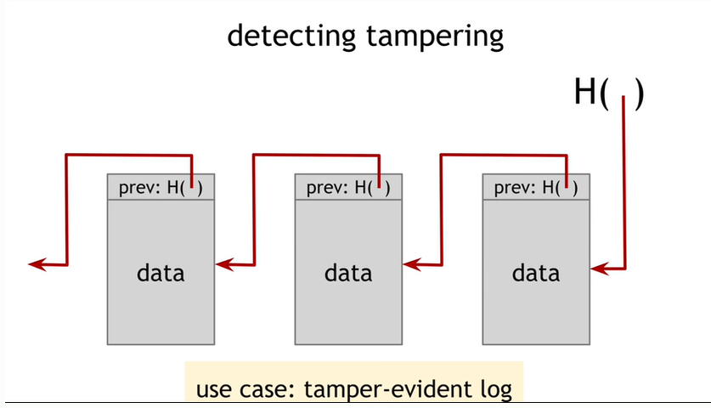
Tamper-evident [append-only] data structure

Slide 8
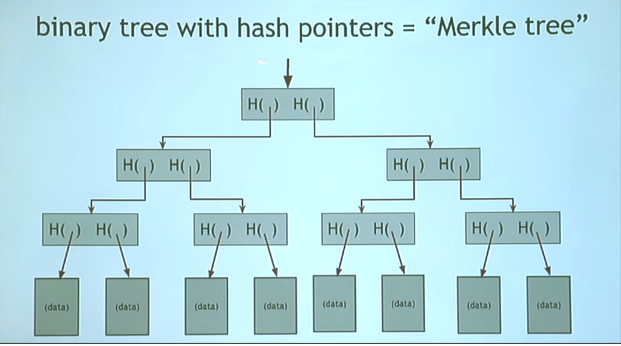

Slide 9
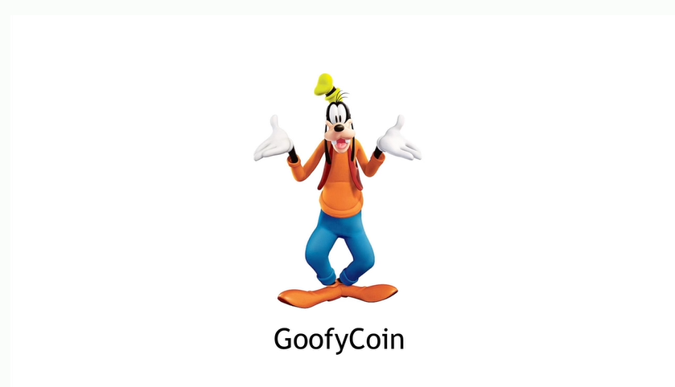
Get rich in 3 simple steps with GoofyCoin! ☺

Slide 10
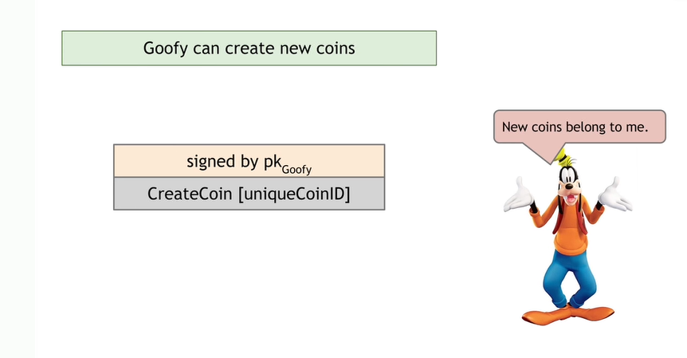

Slide 11
Goofy’s 3-step scheme to get rich:
1.) Mint one million coins
2.) Give away 10,000 of them to friends for free.
3.) Buy 1,000 of them back for $1 each
What’s Goofy’s net worth now?
$999,000 (in coins)

Slide 12
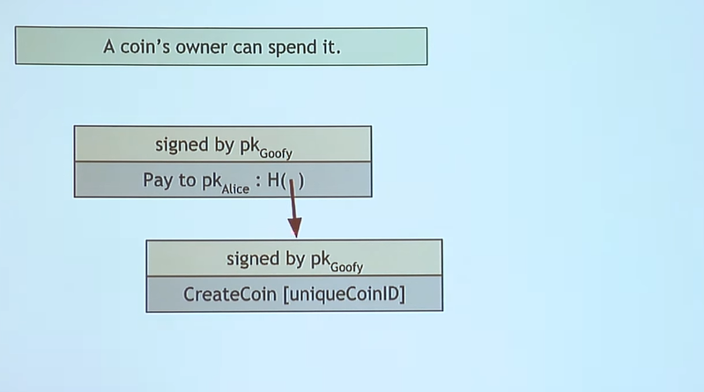

Slide 13
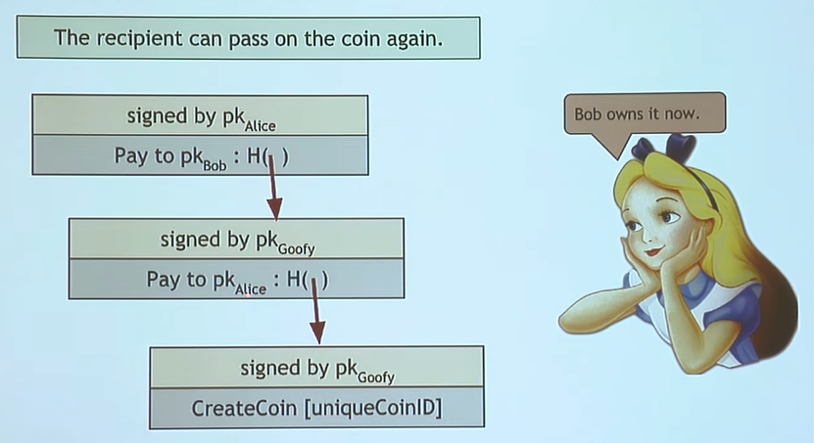

Slide 14
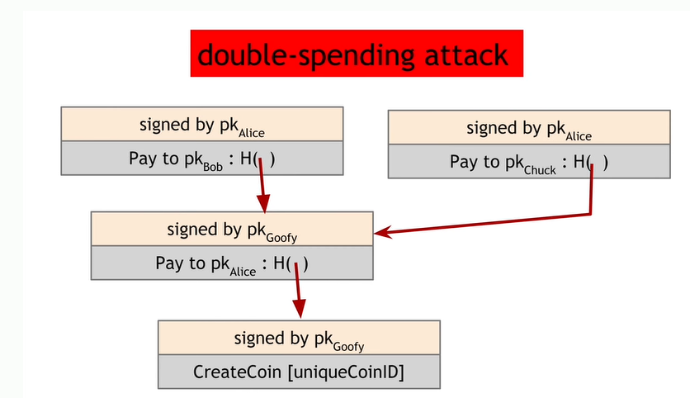

Slide 15
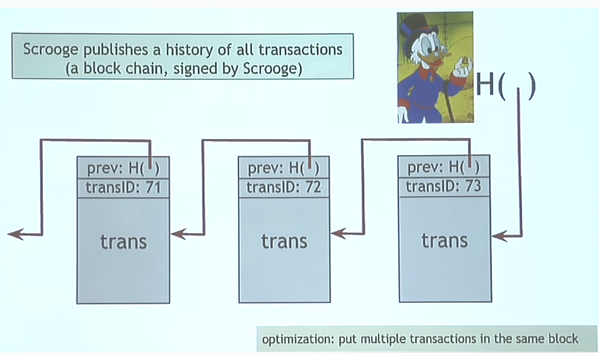

Slide 16
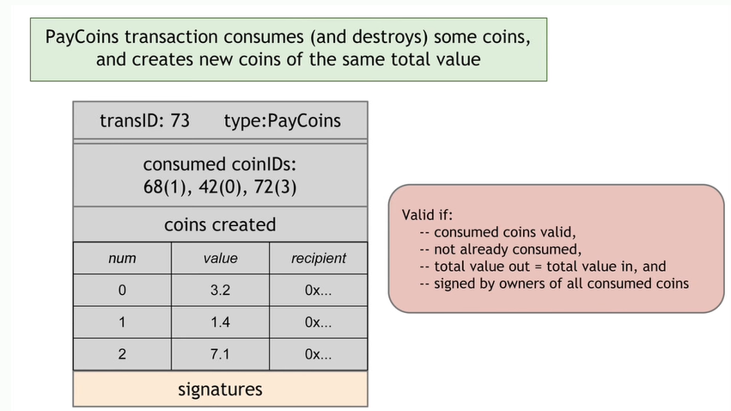

Slide 17
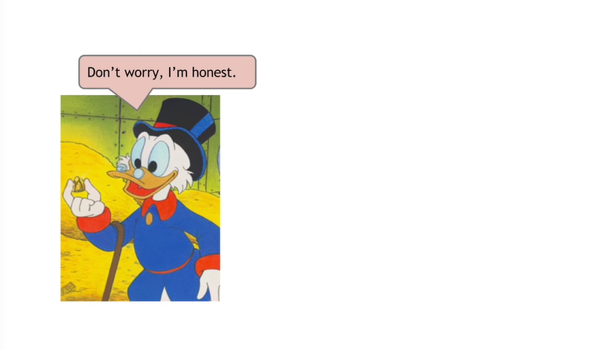

Slide 18
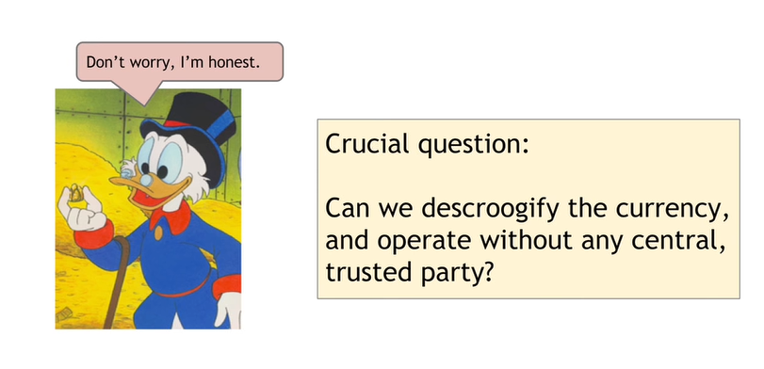

Slide 19
Key challenge (for any distributed e-cash system)
Distributed consensus
Next: how to decentralize ScroodgeCoin

Slide 20
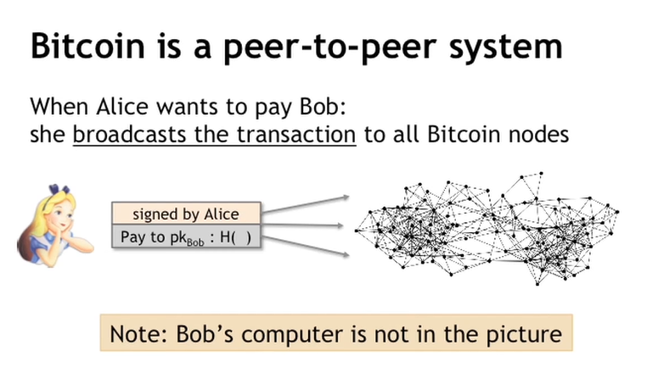

Slide 21
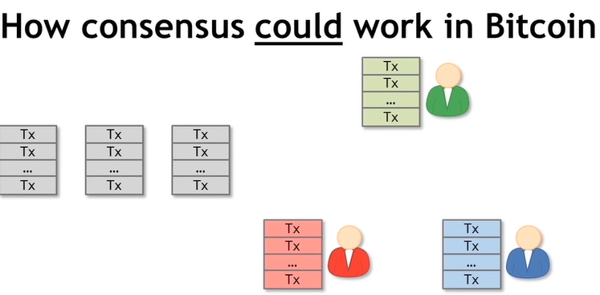
At any given time:
all nodes have a sequence of (blocks of) transactions they have reached agreement on
each node has a set of outstanding transactions if has heard about

Slide 22
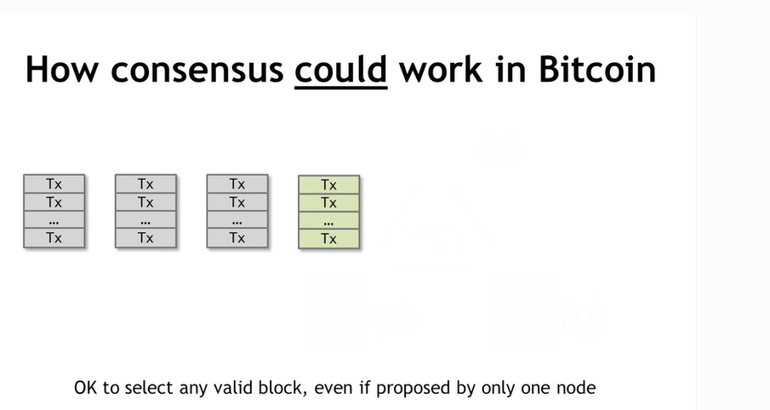
Could run any of the distributed consensus algorithms we have discussed!

Slide 23
Consensus: Impossibility result
Fischer-Lynch-Paterson: consensus impossible to guarantee even with a single faulty node in an asynchronous system.
What’s possible though? Paxos/RAFT
correct (safe) and finish most of the time (mostly live)
transactions are final (i.e., durable)
Byzantine failures: 3F+1 nodes needed to support F faulty nodes (B-PAXOS)
Fail-stop / fail-restart: 2F+1 nodes needed to support F faulty nodes (PAXOS, RAFT)
Consensus in BitCoin - different model
probabilistic transaction finality (system converges)

Slide 24
Traditional consensus protocols require identities
Pragmatic reasons
Security: assume less than ⅓ (B-PAXOS) are malicious

Slide 25
Bitcoin context is different
P2P network: open to anyone / low barrier to enter
Pseudo anonymity is a goal
Consequence
difficult to enforce/use identities (Sybil attack)
hard-identities are a non-goal

Slide 26


Slide 27
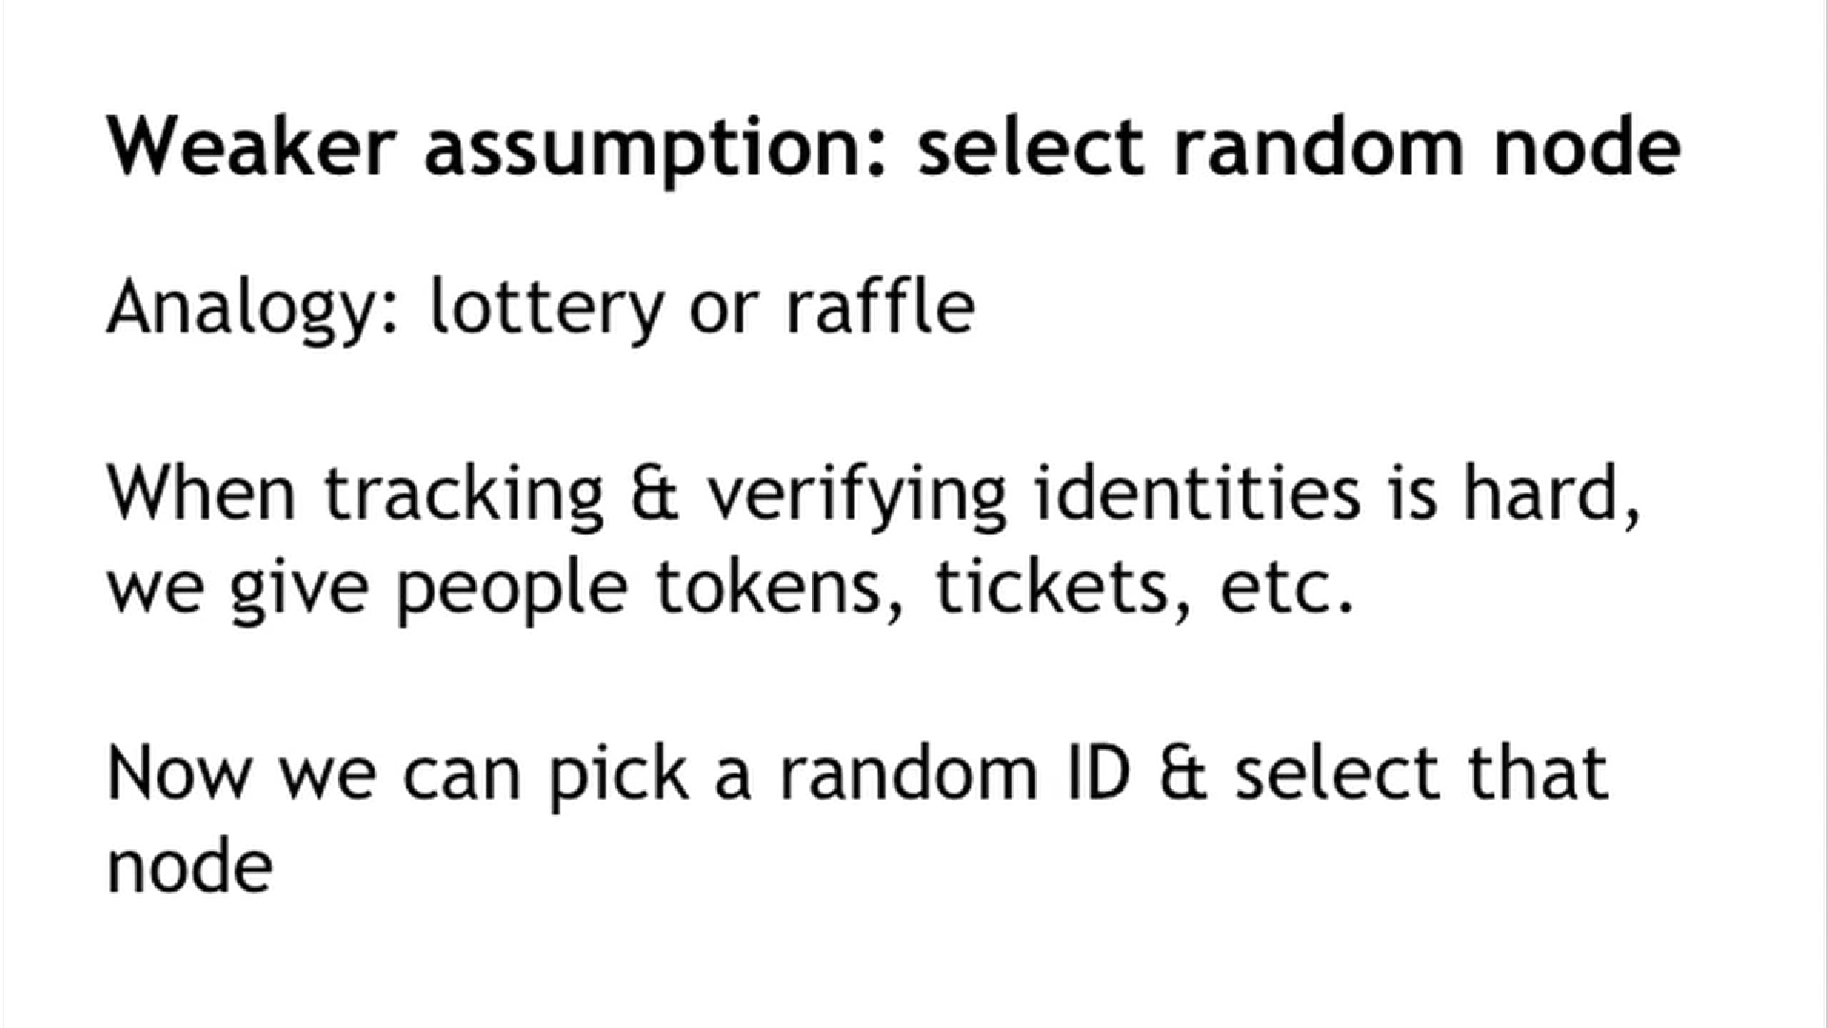

Slide 28
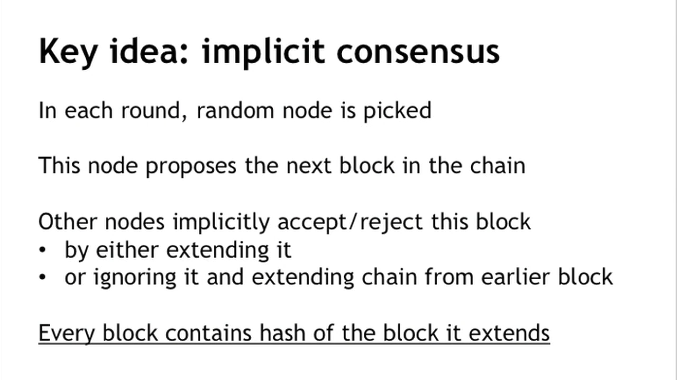

Slide 29
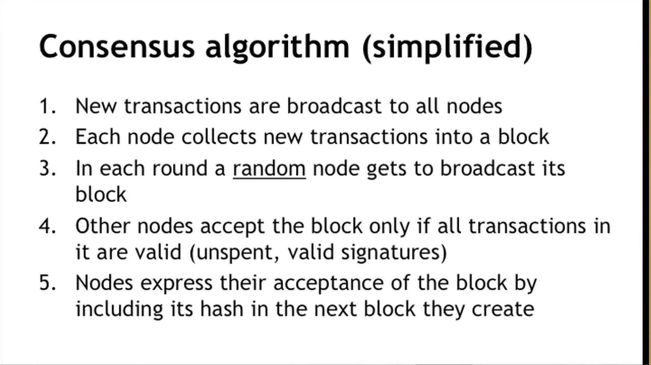

Slide 30
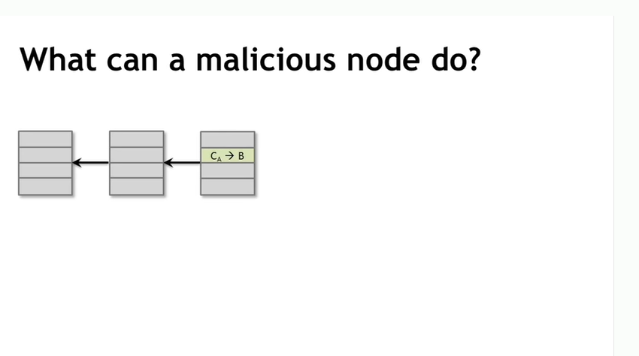
different model
different model

Slide 31
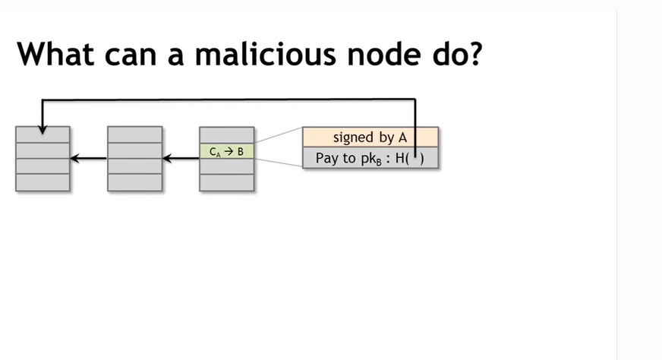

Slide 32
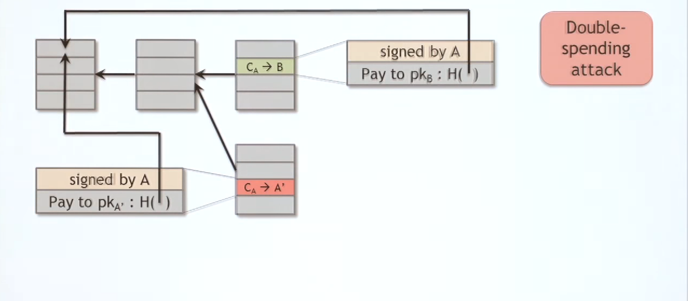

Slide 33
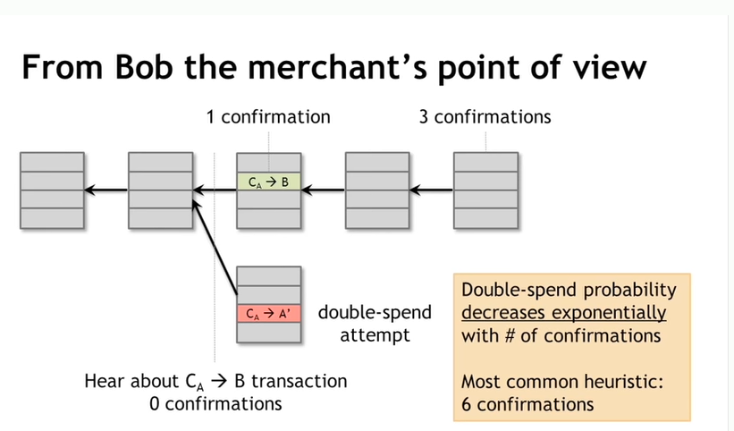

Slide 34
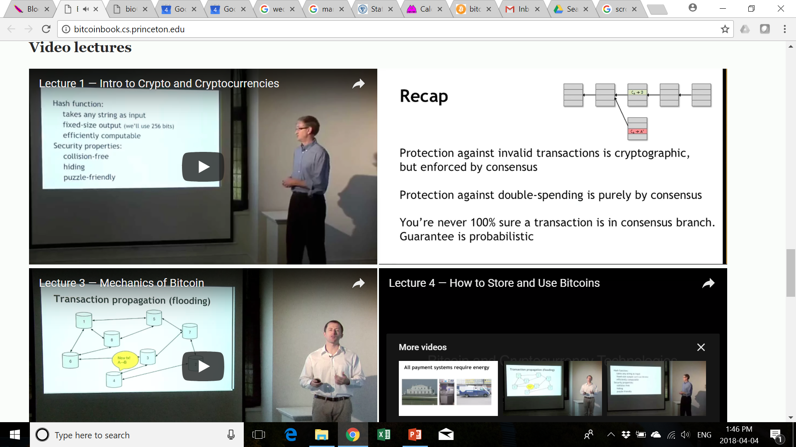

Slide 35
Goals:
block-chains: key insights / reusable design techniques
analyze system from the perspective of the of various topics we’ve studied this term
Centralized vs. Decentralized Distributed System
Distributed Agreement (e.g., Two Phase Commit vs Proof of Work for double spending)
Byzantine Fault-Tolerance
Consistency Models
CAP Theory
Incremental Scalability (vs. blockchain difficulty)
Node Join/Leave
Hash functions and Merkel Trees
… generous topic 🡪 we will run out of time

Slide 37
Goals:
block-chains: key insights / reusable design techniques
analyze system from the perspective of the of various topics we’ve studied this term
Centralized vs. Decentralized Distributed System
Distributed Agreement (e.g., Two Phase Commit vs Proof of Work for double spending)
Byzantine Fault-Tolerance
Consistency Models
CAP Theory
Incremental Scalability (vs. blockchain difficulty)
Node Join/Leave
Hash functions and Merkel Trees
… generous topic 🡪 we will run out of time

Slide 39
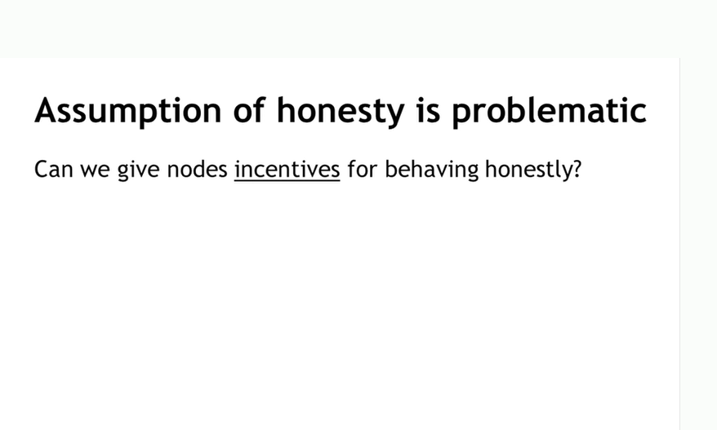

Slide 40
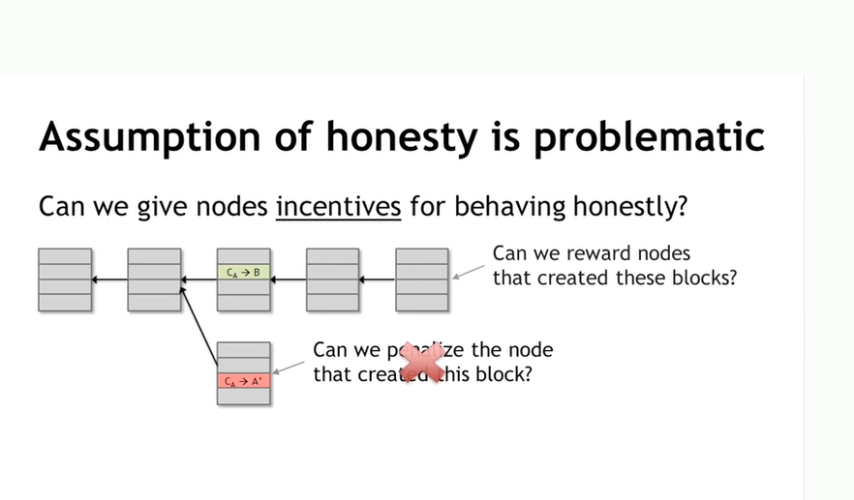

Slide 41


Slide 42
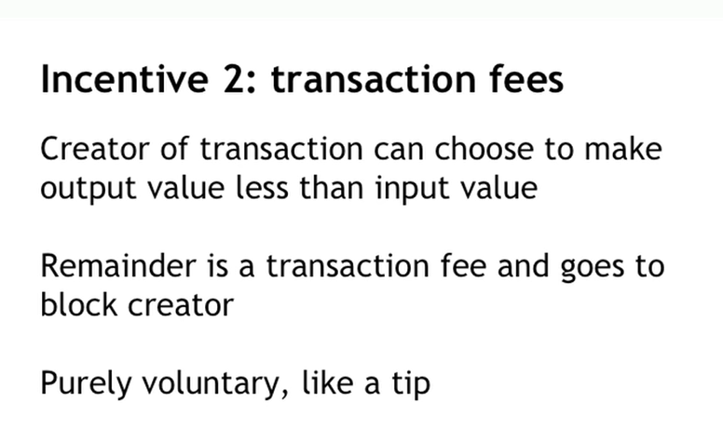

Slide 43
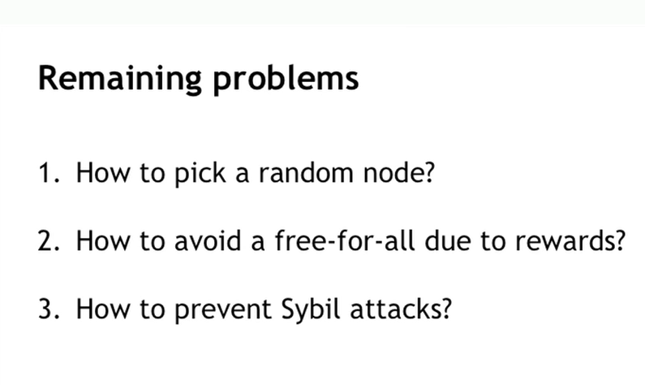

Slide 44
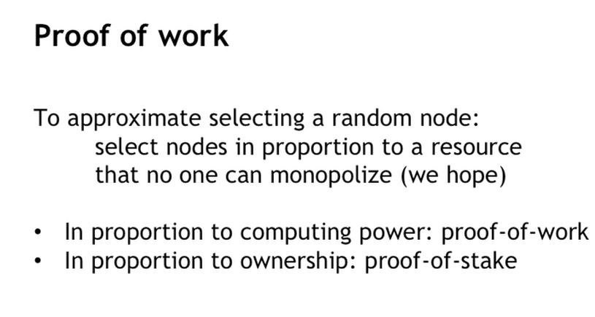

Slide 45
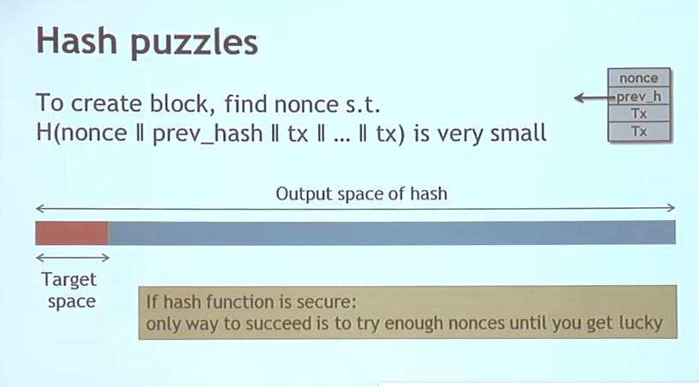

Slide 46
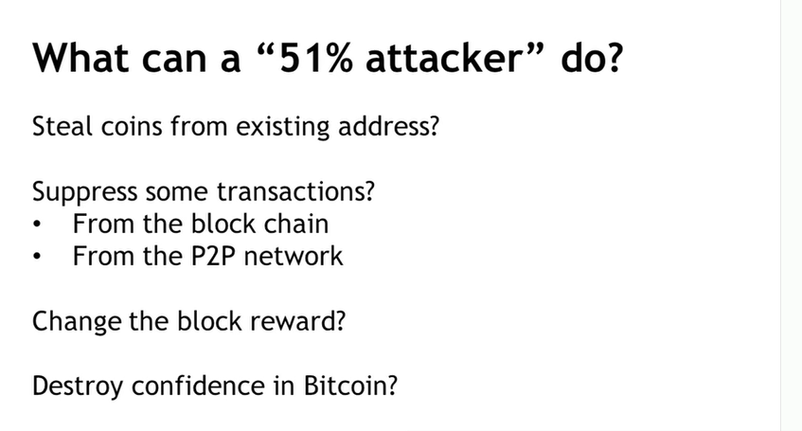

Slide 47
Bitcoin Stories: Bitcoin Cash (Fork)
Updates to software
Core developers trusted by the community, have great power!
Fork on Aug. 1, 2017
Block Size
1MB vs. 32MB
~7 TPS vs. ~100 TPS
Impact?
Higher Transaction Speed?
Now, which is the “real” Bitcoin?
Transactions before Aug. 1, 2017?
Transaction after Aug. 1, 2017?
To fork or not to fork: balancing trust and evolution?

Slide 48
Beyond Bitcoin: Ethereum
Bitcoin
2009
Proof-of-Work
Coins (Bitcoin)
Currency / Store of Value
~ Distributed Transaction Ledger
Deflationary (Fixed Supply / Halved Reward)
ASIC Mining
10 minutes (block time)
~7 TPS
Miners collect Transaction Fees
Ethereum
2015
Proof-of-Stake (originally PoW)
Tokens (Ether)
Smart Contracts / Currency
~ Distributed Computer
Inflationary (Unlimited Supply / Fixed Reward)
GPU Mining
12 seconds (block time)
~15 TPS
Miners collect Gas Fees

Slide 49
Ethereum Stories: The DAO Hack (1/2)
Updates to software
Core developers trusted by the community, have great power!
Fork on July 20th, 2016
A typical DAO (Decentralized Autonomous Organization)
Smart contract developed
Initial Coin Offering (ICO)
After funding, DAO operates
Members vote on how DAO spends money
Notes:
https://www.coindesk.com/learn/understanding-the-dao-attack/

Slide 50
Ethereum Stories: The DAO Hack (2/2)
Smart Contracts: “Code is law”
What about bugs? :)
Fork: Ethereum Classic vs Ethereum
What happened?
The DAO launched on 30th April 2016 with a 28-day funding window.
The DAO was the largest crowdfunding in history: $150M from more than 11,000 members.
The DAO contained roughly 15% of all ether at the time
Saturday, 18th June, an attacker “steals” more than 3.6M ether (> $70M)
The price of ether dropped from over $20 to under $13.
Ethereum forked: 2 opposing “sides”
Impact?
“Code is law”?
Eth. (April 12, 2023): ~$1,900
Eth. Classic (April 12, 2023): ~$22
Notes:
https://www.coindesk.com/learn/understanding-the-dao-attack/

